Slide 1
Frist Internship Project – Calculator in Python
Company: NextHikes IT Solutions
Presented by: Rahiluddin Asif Rohila

Slide 2
What I Created & Why It’s Unique
• Developed a Graphical Calculator using Python and PyQt5.
• Supports operations: Addition, Subtraction, Multiplication, Division, Percentage (%).
• Why add % function?
- Used in real-life for tax, discount, interest, etc.
- Makes the calculator more practical and functional.
• What makes it unique?
- GUI-based, clean layout, user-friendly buttons.

Slide 3
Python Libraries Used and Why
• PyQt5: For GUI (buttons, display, layout).
• sys: For clean program termination.
• Built-in Python Functions: For arithmetic and logic handling.
• Why these?
- Lightweight and easy to learn.
- PyQt5 provides a professional interface.
- Avoided unnecessary complexity.

Slide 4
References Used
• PyQt5 Documentation: https://doc.qt.io/qtforpython/
• YouTube Channels: CodeWithHarry, Tech With Tim, FreeCodeCamp
• W3Schools Python: https://www.w3schools.com/python/
• Stack Overflow: For troubleshooting code errors.
• GeeksForGeeks: For concepts and Python techniques.

Slide 5
Challenges and How I Overcame Them
• GUI Layouts in PyQt5: Solved by using small UI examples and documentation.
• Button Function Mapping: Used lambda functions and connect().
• Error Handling (e.g., divide by zero): Used try-except blocks.
• % Function Logic: Defined as percentage of a number (e.g., 20% of 150 = 30).

Slide 6
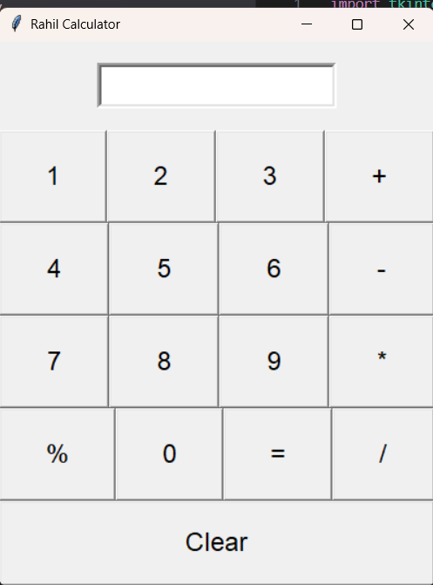
Calculator Interface Snapshot

Slide 7
Thank You
• Thank you for reviewing my project.
• I appreciate the opportunity to learn and grow at NextHikes IT Solutions.
• Open to feedback and suggestions.

